Slide 1

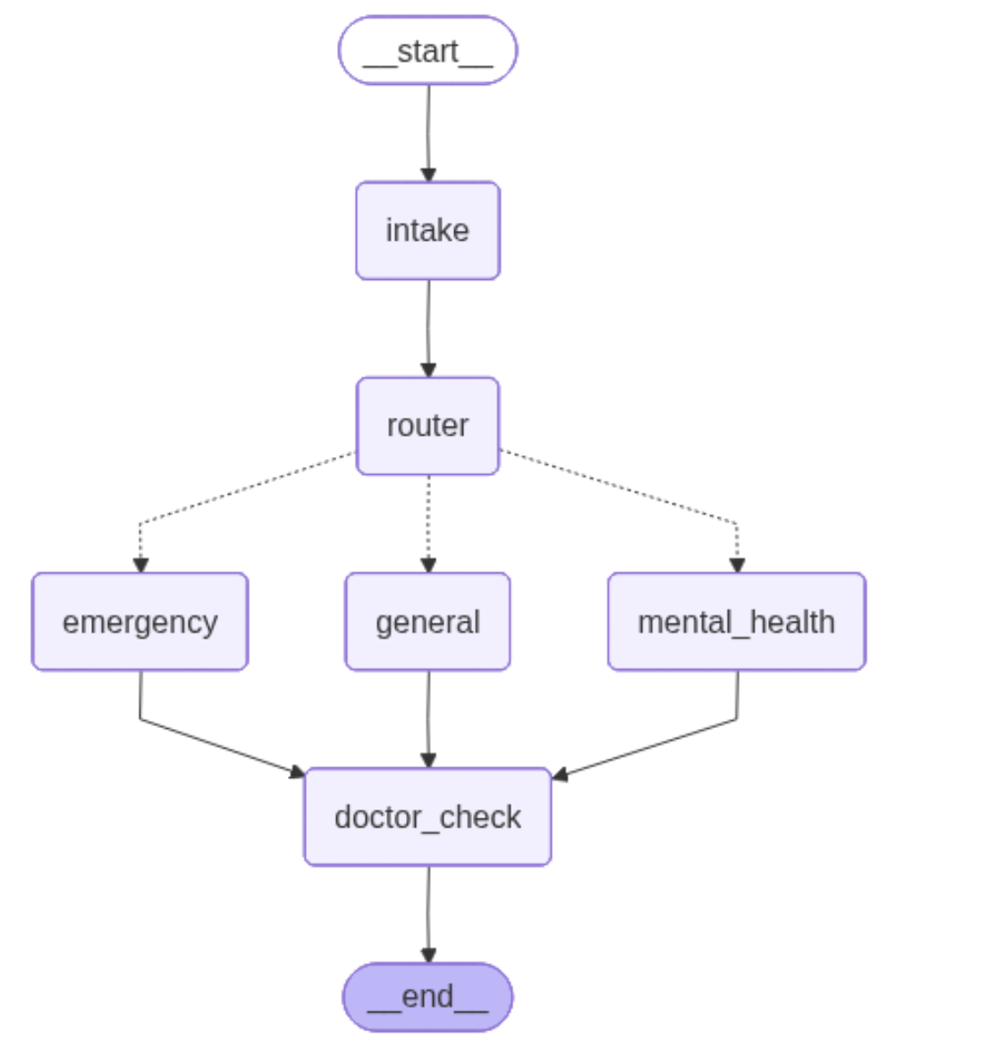
Amity Institute of Information Technology
MCA Student Names:
1. Dheeraj Kumar
Project Title: MedFlow AI – Intelligent Triage & Scheduling
Introduction
Diagram
MedFlow AI is an automated clinical assistant designed to optimize hospital patient entry points. By decoupling the architecture into a responsive Web Portal and a FastAPI backend running a LangGraph agent workflow, the system dynamically routes incoming patients to appropriate wards (Emergency, Mental Health, General) and allocates doctors' slots in real-time.
Technology Used/Working Model Snaps
Utility/Applications
• Headless Python Backend: FastAPI server.
• Orchestration: LangGraph & LangChain agent.
• LLM Analysis: Llama 3.3 (70B) via Groq API.
• Client Portal: Glassmorphic HTML5 / CSS3 / JS.
• Data: Local persistent CSV files.
• Automated Triage routing bypassing manual reception desk lines.
• Resource Optimization by chronologically calculating doctor scheduling times.
• Incident Logger persisting classification reasoning to CSV audit database.
• Hybrid Guardrails applying keyword safety rules for emergency alerts.

